Slide 1
19CS3113S
Analysis and Design of Algorithms
Session -31 & 32

Slide 2

TRAVELLING SALESMAN PROBLEM
Let G = (V, E) be a directed graph.
The problem is to find a tour of minimum cost and we
assume that every tour starts and ends at vertex 1.
So, the solution space S is given by S = {(1, r, 1)| where r is a
permutation of (2,3, ... ,n)}.
Therefore S= (n — 1)!

Slide 3
For the given matrix first obtain reduced cost matrix.
A matrix is reduced iff every row and column is reduced.
A row (column) is said to be reduced iff it contains at least one zero and all remaining entries are non-negative.
Let A be the reduced cost matrix for node R.
Let S be a child of R such that the tree edge (R, S) corresponds to including edge (i, j) in the tour.
If S is not a leaf, then the reduced cost matrix for S may be obtained as follows:
1.Change all entries in row i and column j of A to oo.
2. Set A(j,1) to oo.
3.Reduce all rows and columns in the resulting matrix except for rows and columns containing only oo. Let the resulting matrix be B.
4.C(S)=C(R )+A(i,j)+ r where r is the total amount subtracted in step (3)

Slide 4
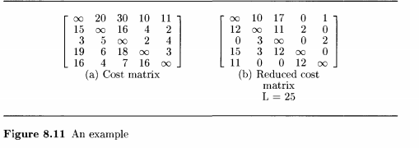

Slide 5
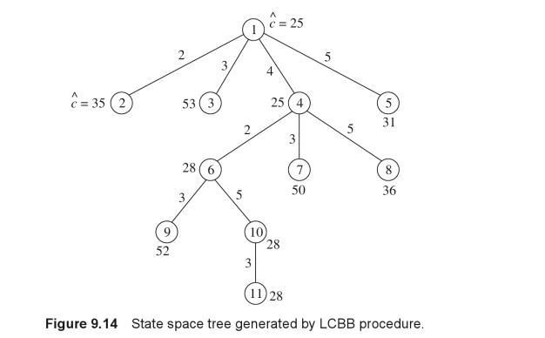

Slide 6
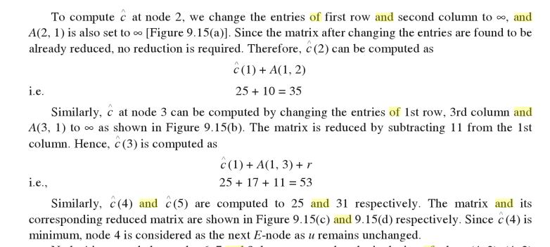

Slide 7
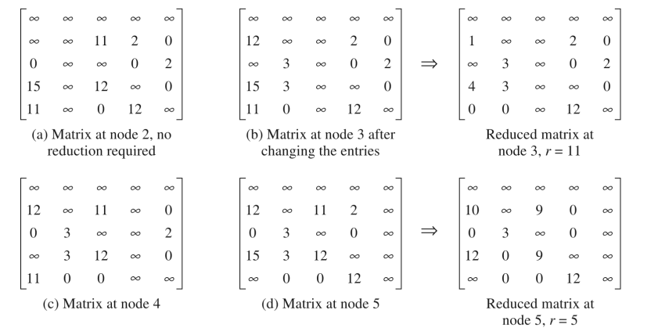

Slide 8
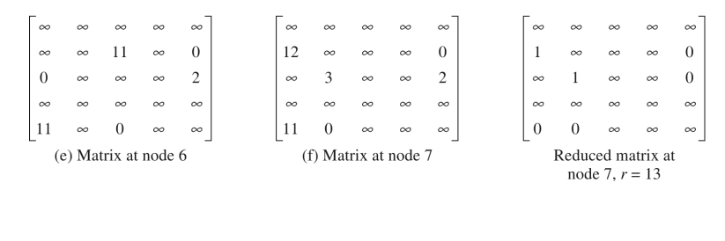

Slide 9
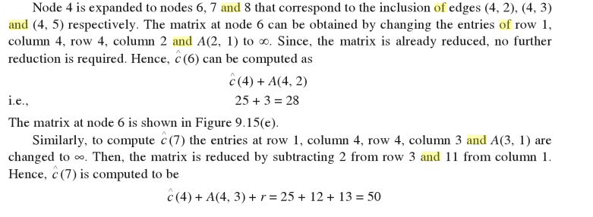


Slide 10
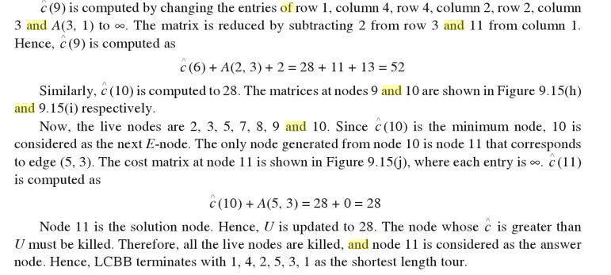

Slide 11
Thank you

